Slide 1

Telegram bot
Name – Cspedia
Username - @pro_gambot

Slide 2
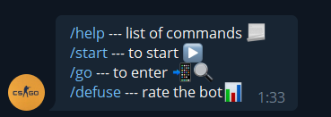
Commands
/start – to start the bot
/help – the list of commands
/go – to enter name of the team or gamer
/defuse – to rate the bot

Slide 3
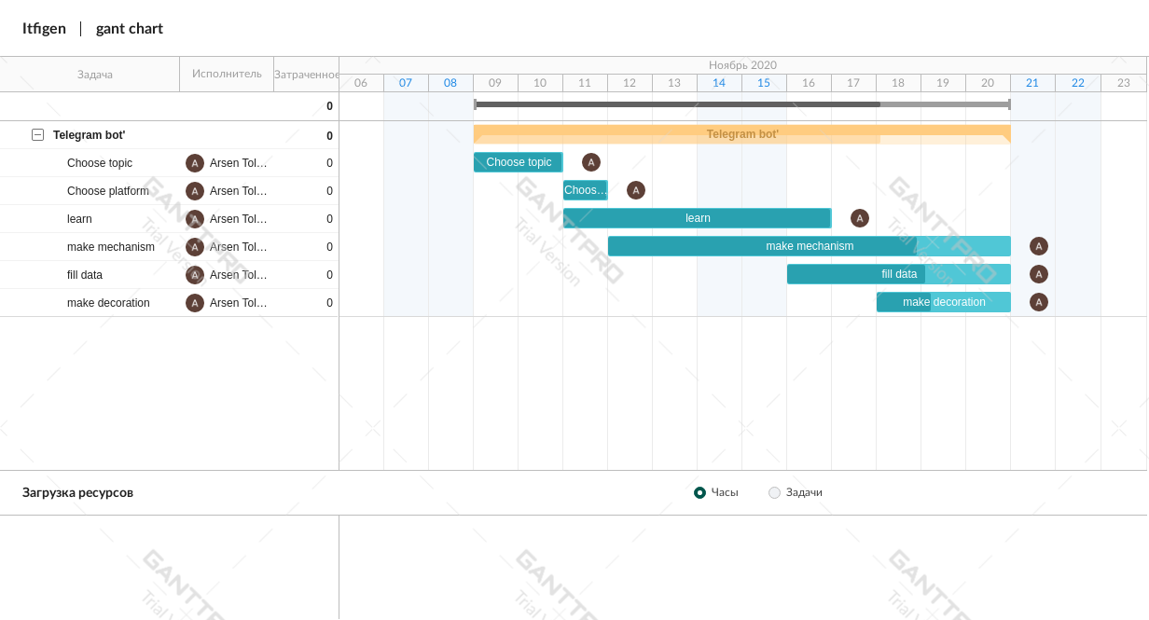
Gantt chart

Slide 4
Problem I faced
Bot was always keeping data in memory so it wasn’t working with next message
Sending sticker also was problematic
Problem with syntax (Python is new language for me)

Slide 5

Conclusion

Slide 6
Thanks for your attention!

